Slide 1


GitHub Repo
IACV Project
Vehicle Space Occupancy
A.A. 2024-2025
Ermelinda Giulivo
10790499
ermelinda.giulivo@mail.polimi.it
Luca Masiero
10683660
luca3.masiero@mail.polimi.it

Slide 2

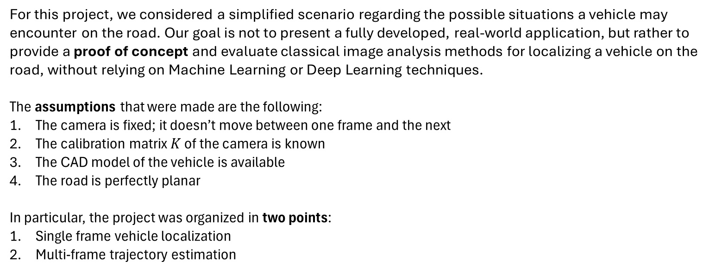
Point 1: Single Frame Vehicle Localization
Project Overview
For this project, we considered a simplified scenario regarding the possible situations a vehicle may encounter on the road. Our goal is not to present a fully developed, real-world application, but rather to provide a proof of concept and evaluate classical image analysis methods for localizing a vehicle on the road, without relying on Machine Learning or Deep Learning techniques.
The assumptions that were made are the following:
The camera is fixed; it doesn’t move between one frame and the next
The calibration matrix $K$ of the camera is known
The CAD model of the vehicle is available
The road is perfectly planar
In particular, the project was organized in two points:
Single frame vehicle localization
Multi-frame trajectory estimation

Slide 3
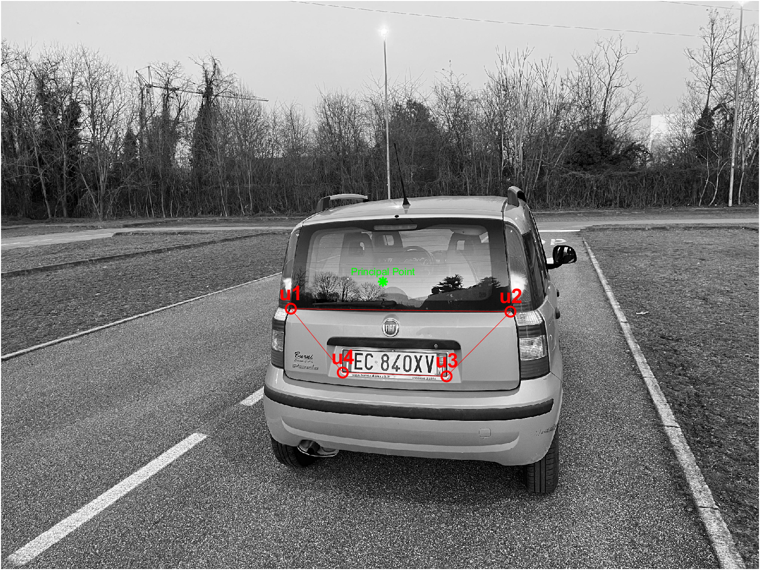
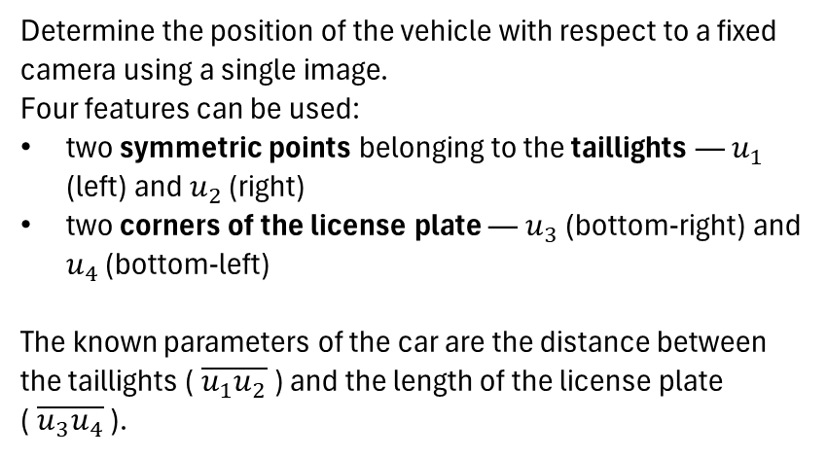
Point 1: Single Frame Vehicle Localization
Point 1 >> Objective
Determine the position of the vehicle with respect to a fixed camera using a single image.
Four features can be used:
two symmetric points belonging to the taillights — $u_{1}$ (left) and $u_{2}$ (right)
two corners of the license plate — $u_{3}$ (bottom-right) and $u_{4}$ (bottom-left)
The known parameters of the car are the distance between the taillights ($\overline{u_{1}u_{2}}$ ) and the length of the license plate ($\overline{u_{3}u_{4}}$ ).

Slide 4
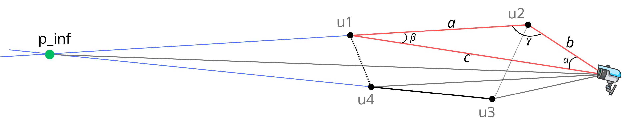
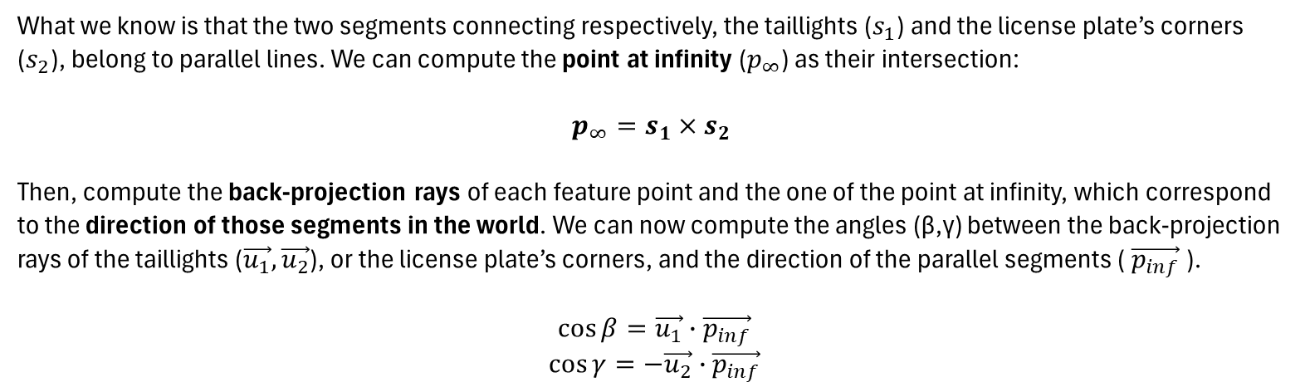
Point 1: Single Frame Vehicle Localization
Point 1 >> Method
What we know is that the two segments connecting respectively, the taillights ($s_{1}$) and the license plate’s corners ($s_{2}$), belong to parallel lines. We can compute the point at infinity ($p_{∞}$) as their intersection:
$$p_{∞}=s_{1}×s_{2}$$
Then, compute the back-projection rays of each feature point and the one of the point at infinity, which correspond to the direction of those segments in the world. We can now compute the angles (β,γ) between the back-projection rays of the taillights ($\vec{u_{1}},\vec{u_{2}}$), or the license plate’s corners, and the direction of the parallel segments ($\vec{p_{inf}}$).
$$\cos{β}=\vec{u_{1}}∙\vec{p_{inf}}$$
$$\cos{γ}=−\vec{u_{2}}∙\vec{p_{inf}}$$

Slide 5
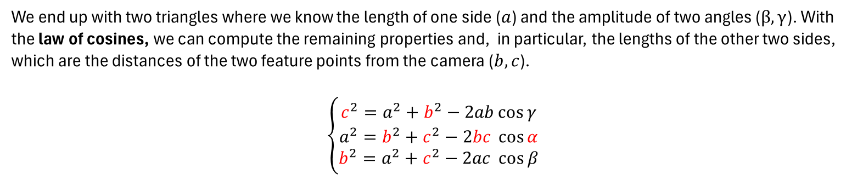
Point 1: Single Frame Vehicle Localization
Point 1 >> Method
We end up with two triangles where we know the length of one side ($a$) and the amplitude of two angles ($β,γ$). With the law of cosines, we can compute the remaining properties and, in particular, the lengths of the other two sides, which are the distances of the two feature points from the camera ($b, c$).
$$\left\{\begin{aligned}c^{2}=a^{2}+b^{2}−2ab\cos{γ} \\ a^{2}=b^{2}+c^{2}−2bc \cos{α} \\ b^{2}=a^{2}+c^{2}−2ac \cos{β}\end{aligned}\right.$$

Slide 6
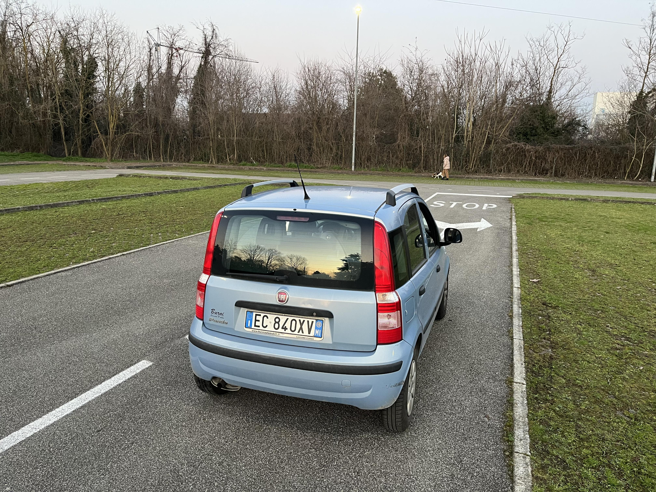
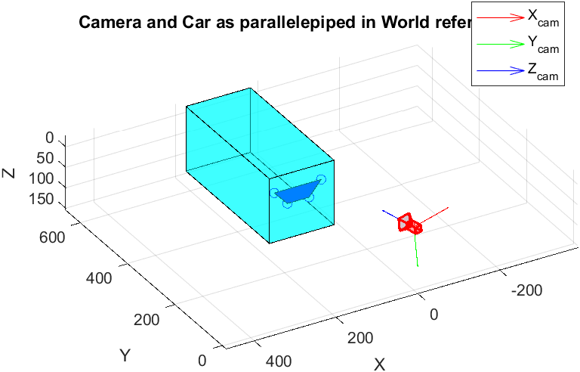
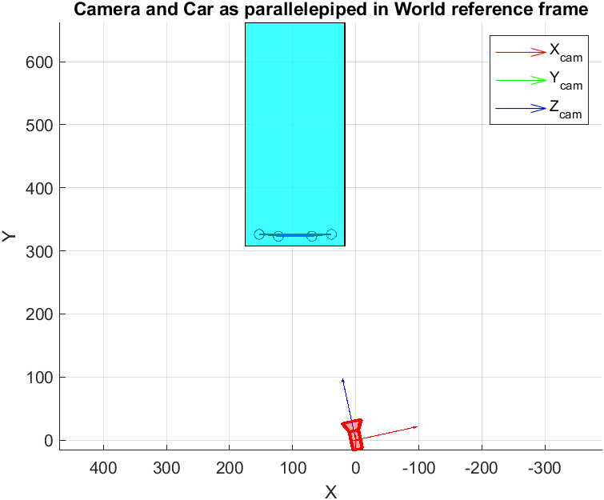
Point 1: Single Frame Vehicle Localization
Point 1 >> Results
The results obtained were sufficiently good, even though not perfect. A possible source of error may be the manual feature selection.
What we have noticed is that the algorithm is quite robust when the car is near to the camera, while it becomes less accurate when the car is further away from the camera. This can be expected since the two feature segments get smaller causing considerable movements of the intersection point even with small changes in the features coordinates.

Slide 7
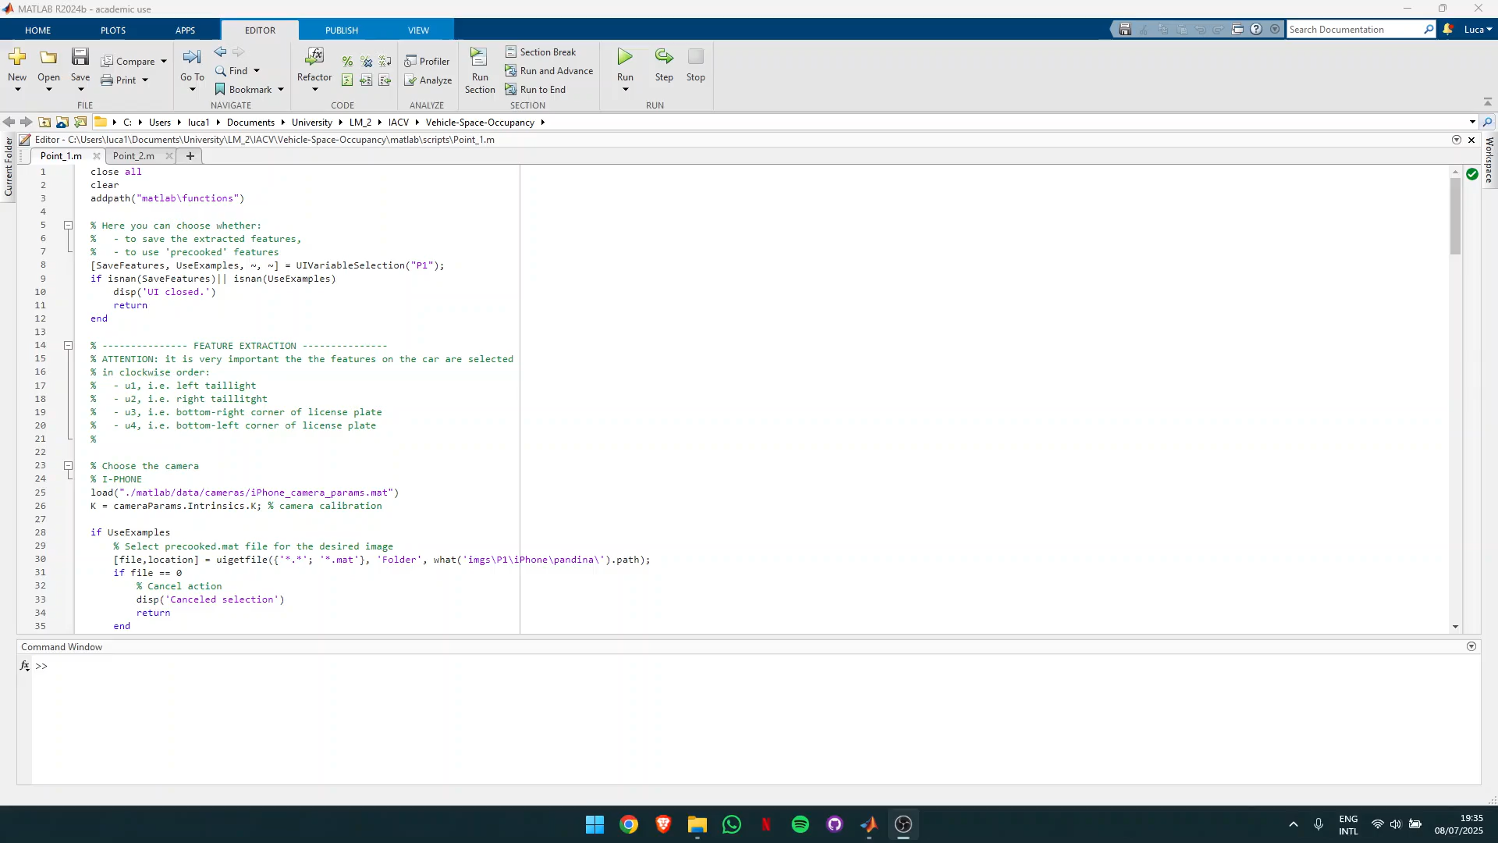
Point 1: Single Frame Vehicle Localization
Point 1 >> Small Demonstration
This and other videos can be found in the README.md file in the GitHub repository.

Slide 8
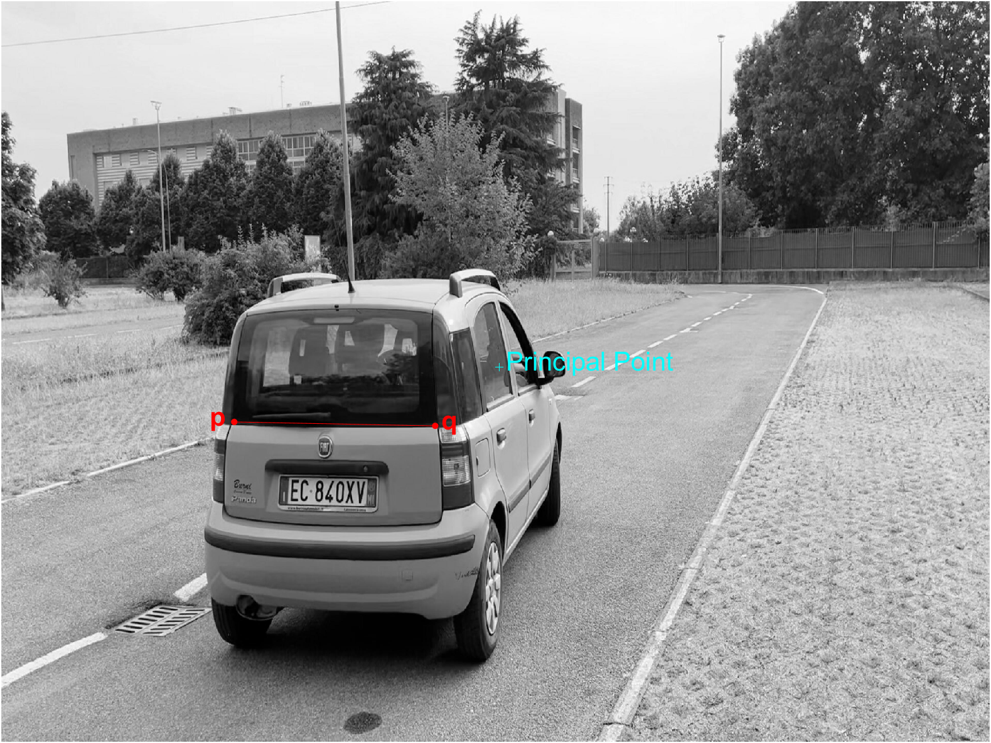
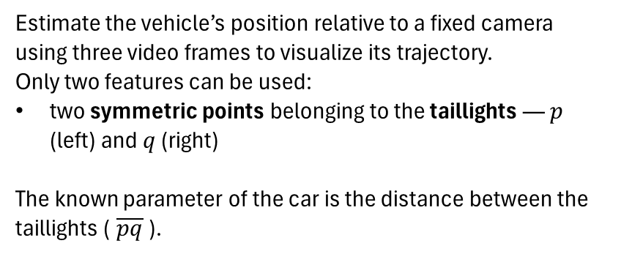
Point 2: Multi-Frame Trajectory Estimation
Point 2 >> Objective
Estimate the vehicle’s position relative to a fixed camera using three video frames to visualize its trajectory.
Only two features can be used:
two symmetric points belonging to the taillights — $p$ (left) and $q$ (right)
The known parameter of the car is the distance between the taillights ($\overline{pq}$ ).

Slide 9
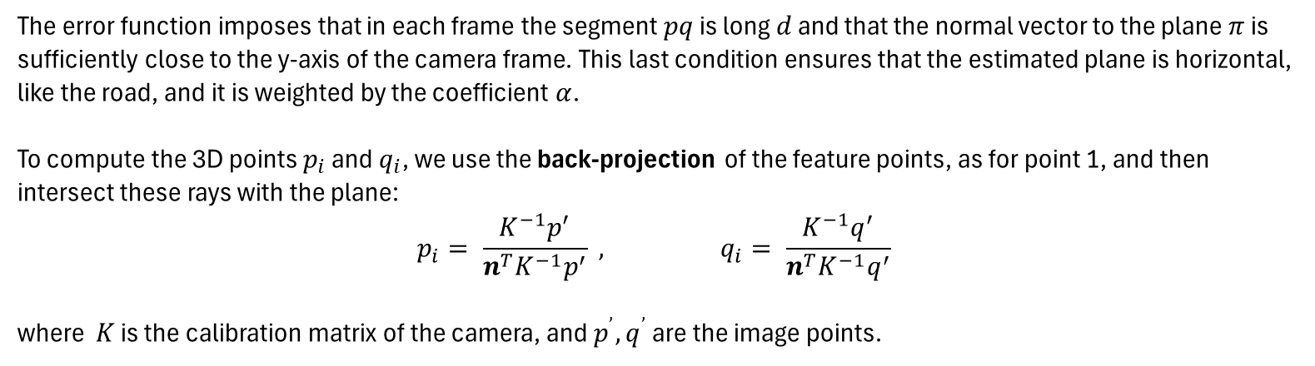
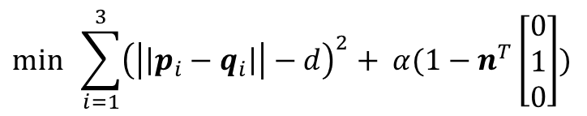
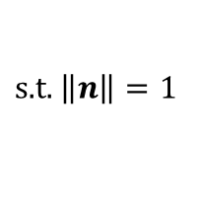
Point 2: Multi-Frame Trajectory Estimation
Point 2 >> Method
The algorithm uses the assumption that the feature points of the three frames all belong to the same plane $π$, which can be defined through its normal vector $n$. To estimate this vector, we use a minimization problem, defined as follows:
$$\min{\sum_{i=1}^{3}{{\left(\left|\left|p_{i}−q_{i}\right|\right|−d\right)}^{2}}+ α(1−n^{T}\left[\begin{matrix}0 \\ 1 \\ 0\end{matrix}\right])}$$
$$\text{s}\text{.}\text{t}\text{. }\left\|\left.n\right\|=1\right.$$
The error function imposes that in each frame the segment $pq$ is long $d$ and that the normal vector to the plane $π$ is sufficiently close to the y-axis of the camera frame. This last condition ensures that the estimated plane is horizontal, like the road, and it is weighted by the coefficient $α$.
To compute the 3D points $p_{i}$ and $q_{i}$, we use the back-projection of the feature points, as for point 1, and then intersect these rays with the plane:
$$p_{i}= \frac{K^{−1}p^{′}}{n^{T}K^{−1}p^{′}} , q_{i}= \frac{K^{−1}q^{′}}{n^{T}K^{−1}q^{′}}$$
where $K$ is the calibration matrix of the camera, and $p^{’}, q^{’}$ are the image points.

Slide 10
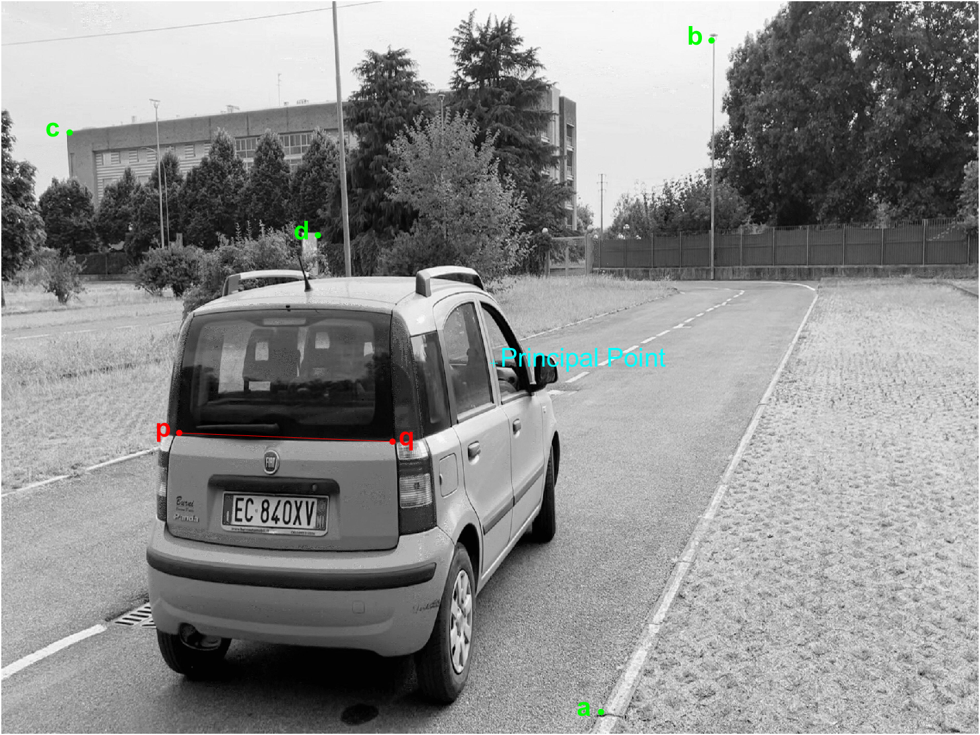
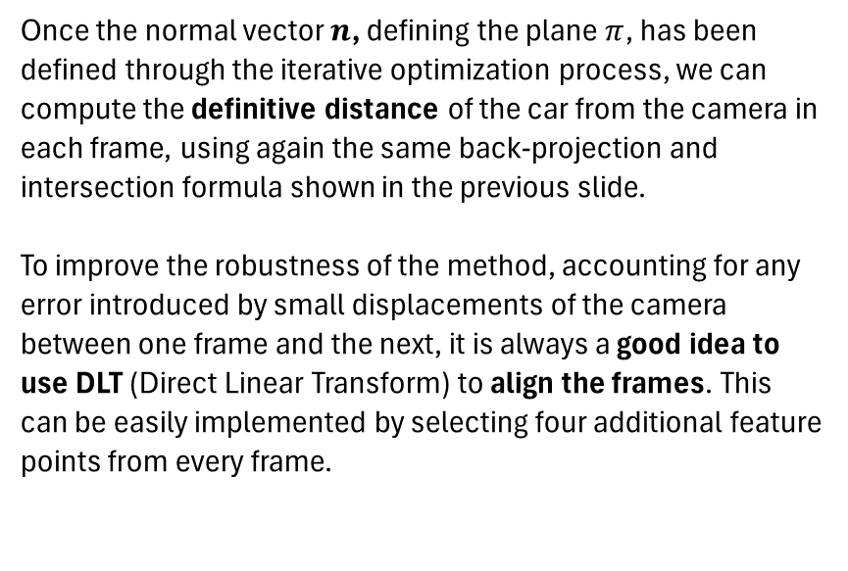
Point 2: Multi-Frame Trajectory Estimation
Point 2 >> Method
Once the normal vector $n$, defining the plane $π$, has been defined through the iterative optimization process, we can compute the definitive distance of the car from the camera in each frame, using again the same back-projection and intersection formula shown in the previous slide.
To improve the robustness of the method, accounting for any error introduced by small displacements of the camera between one frame and the next, it is always a good idea to use DLT (Direct Linear Transform) to align the frames. This can be easily implemented by selecting four additional feature points from every frame.

Slide 11
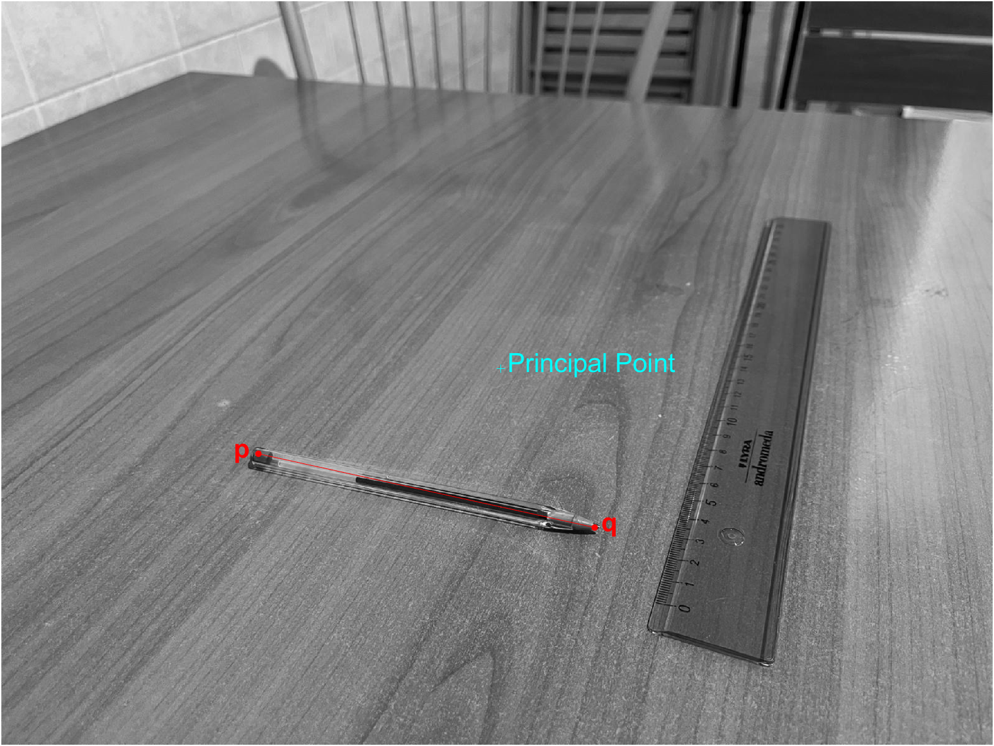
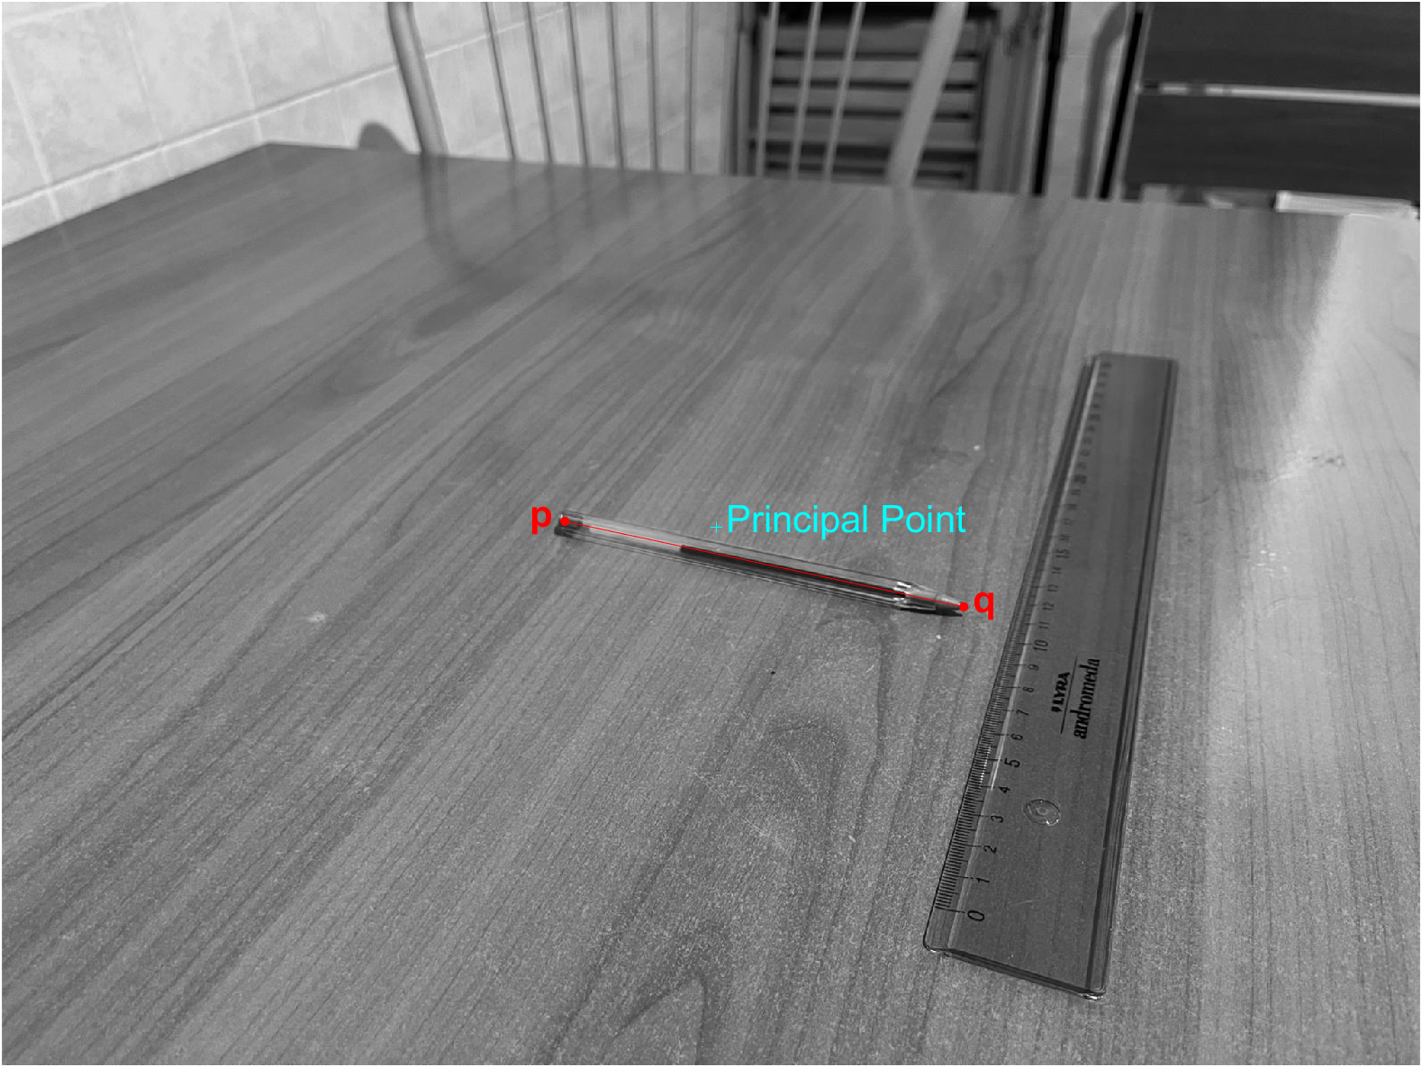
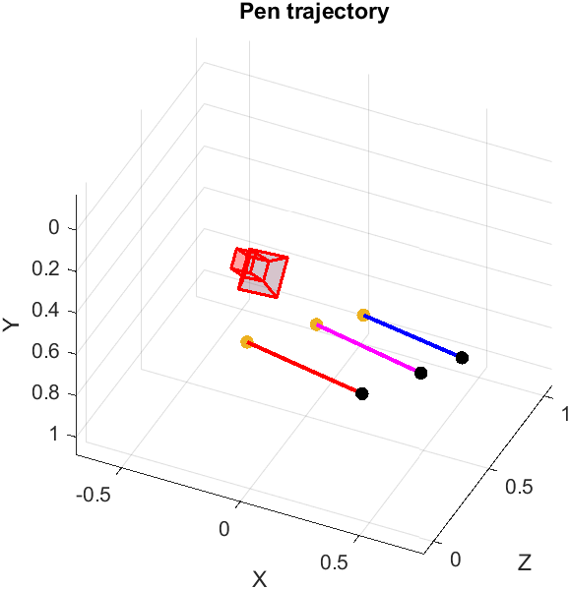
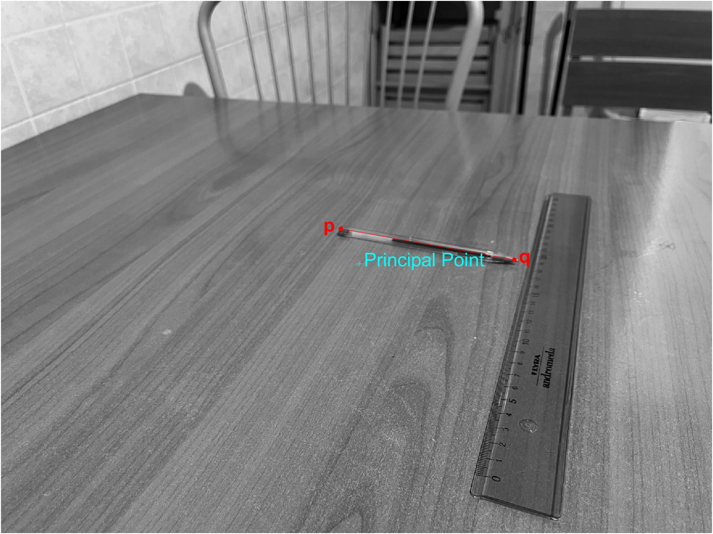
Point 2: Multi-Frame Trajectory Estimation
Point 2 >> Testing
To evaluate the correctness of the algorithm we tested it on a much simpler scenario: we used a pen to simulate the segment $pq$ and moved on a table as a car would do on a road.
1
2
3

Slide 12
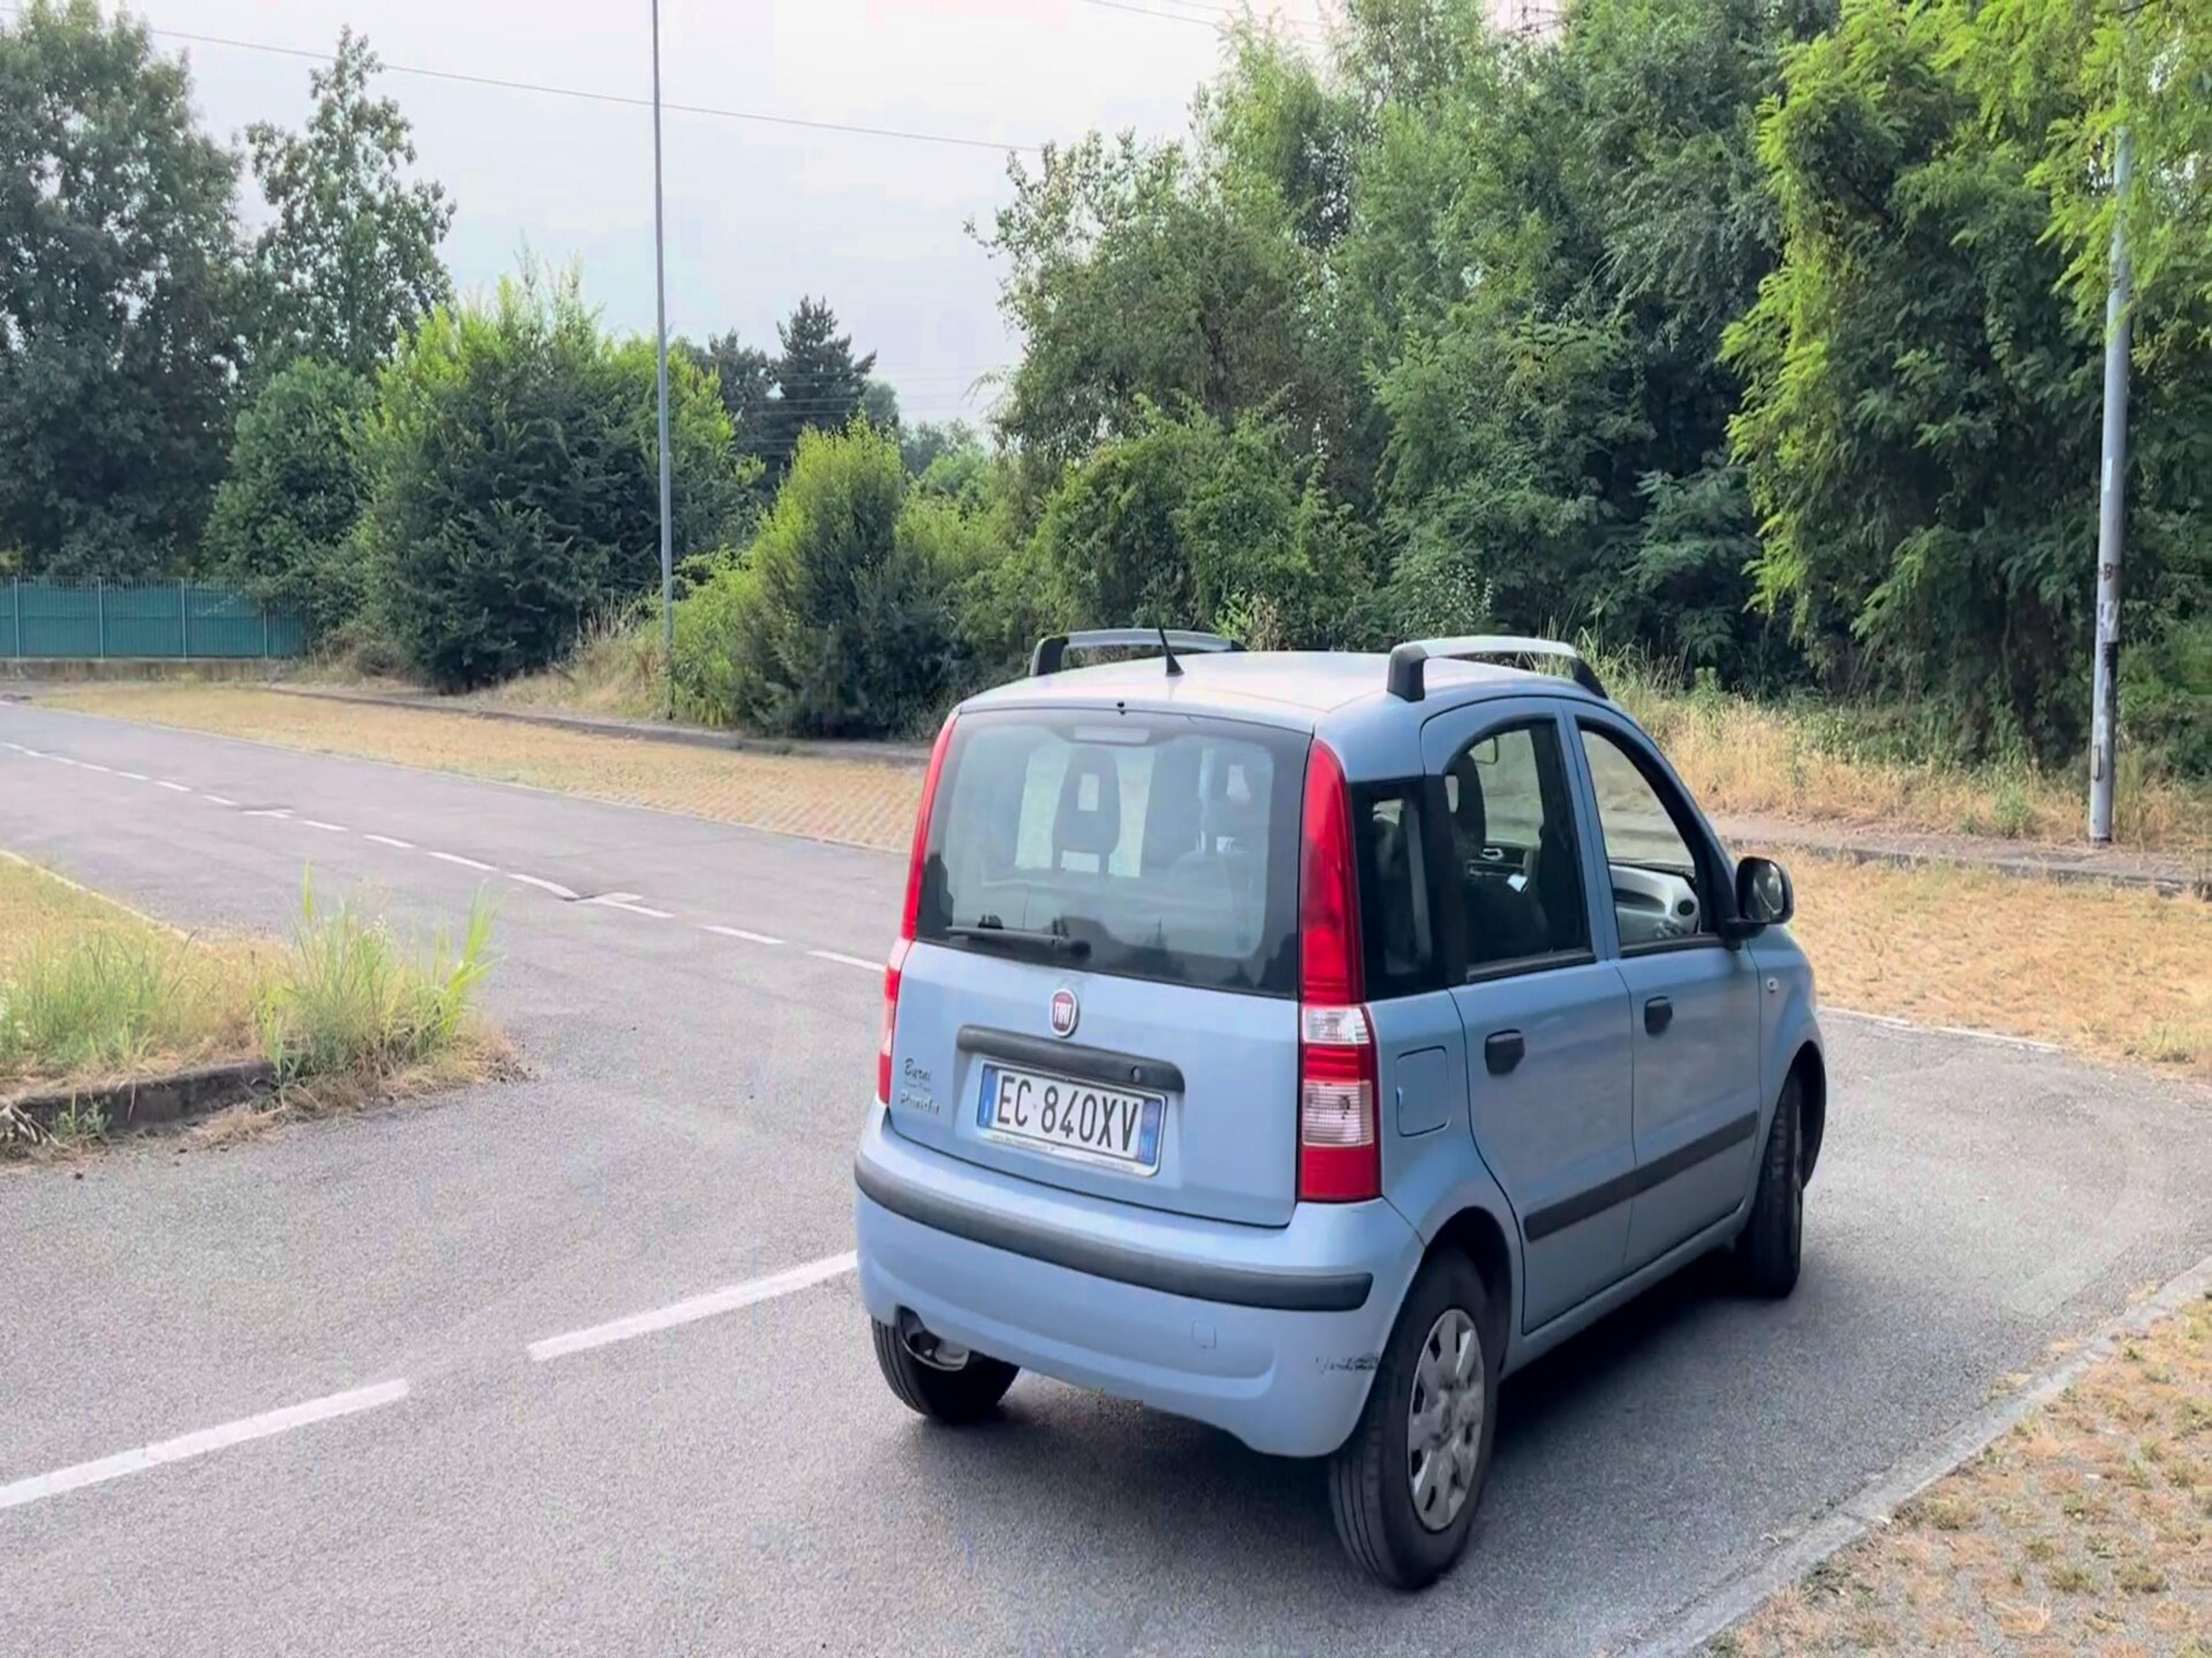
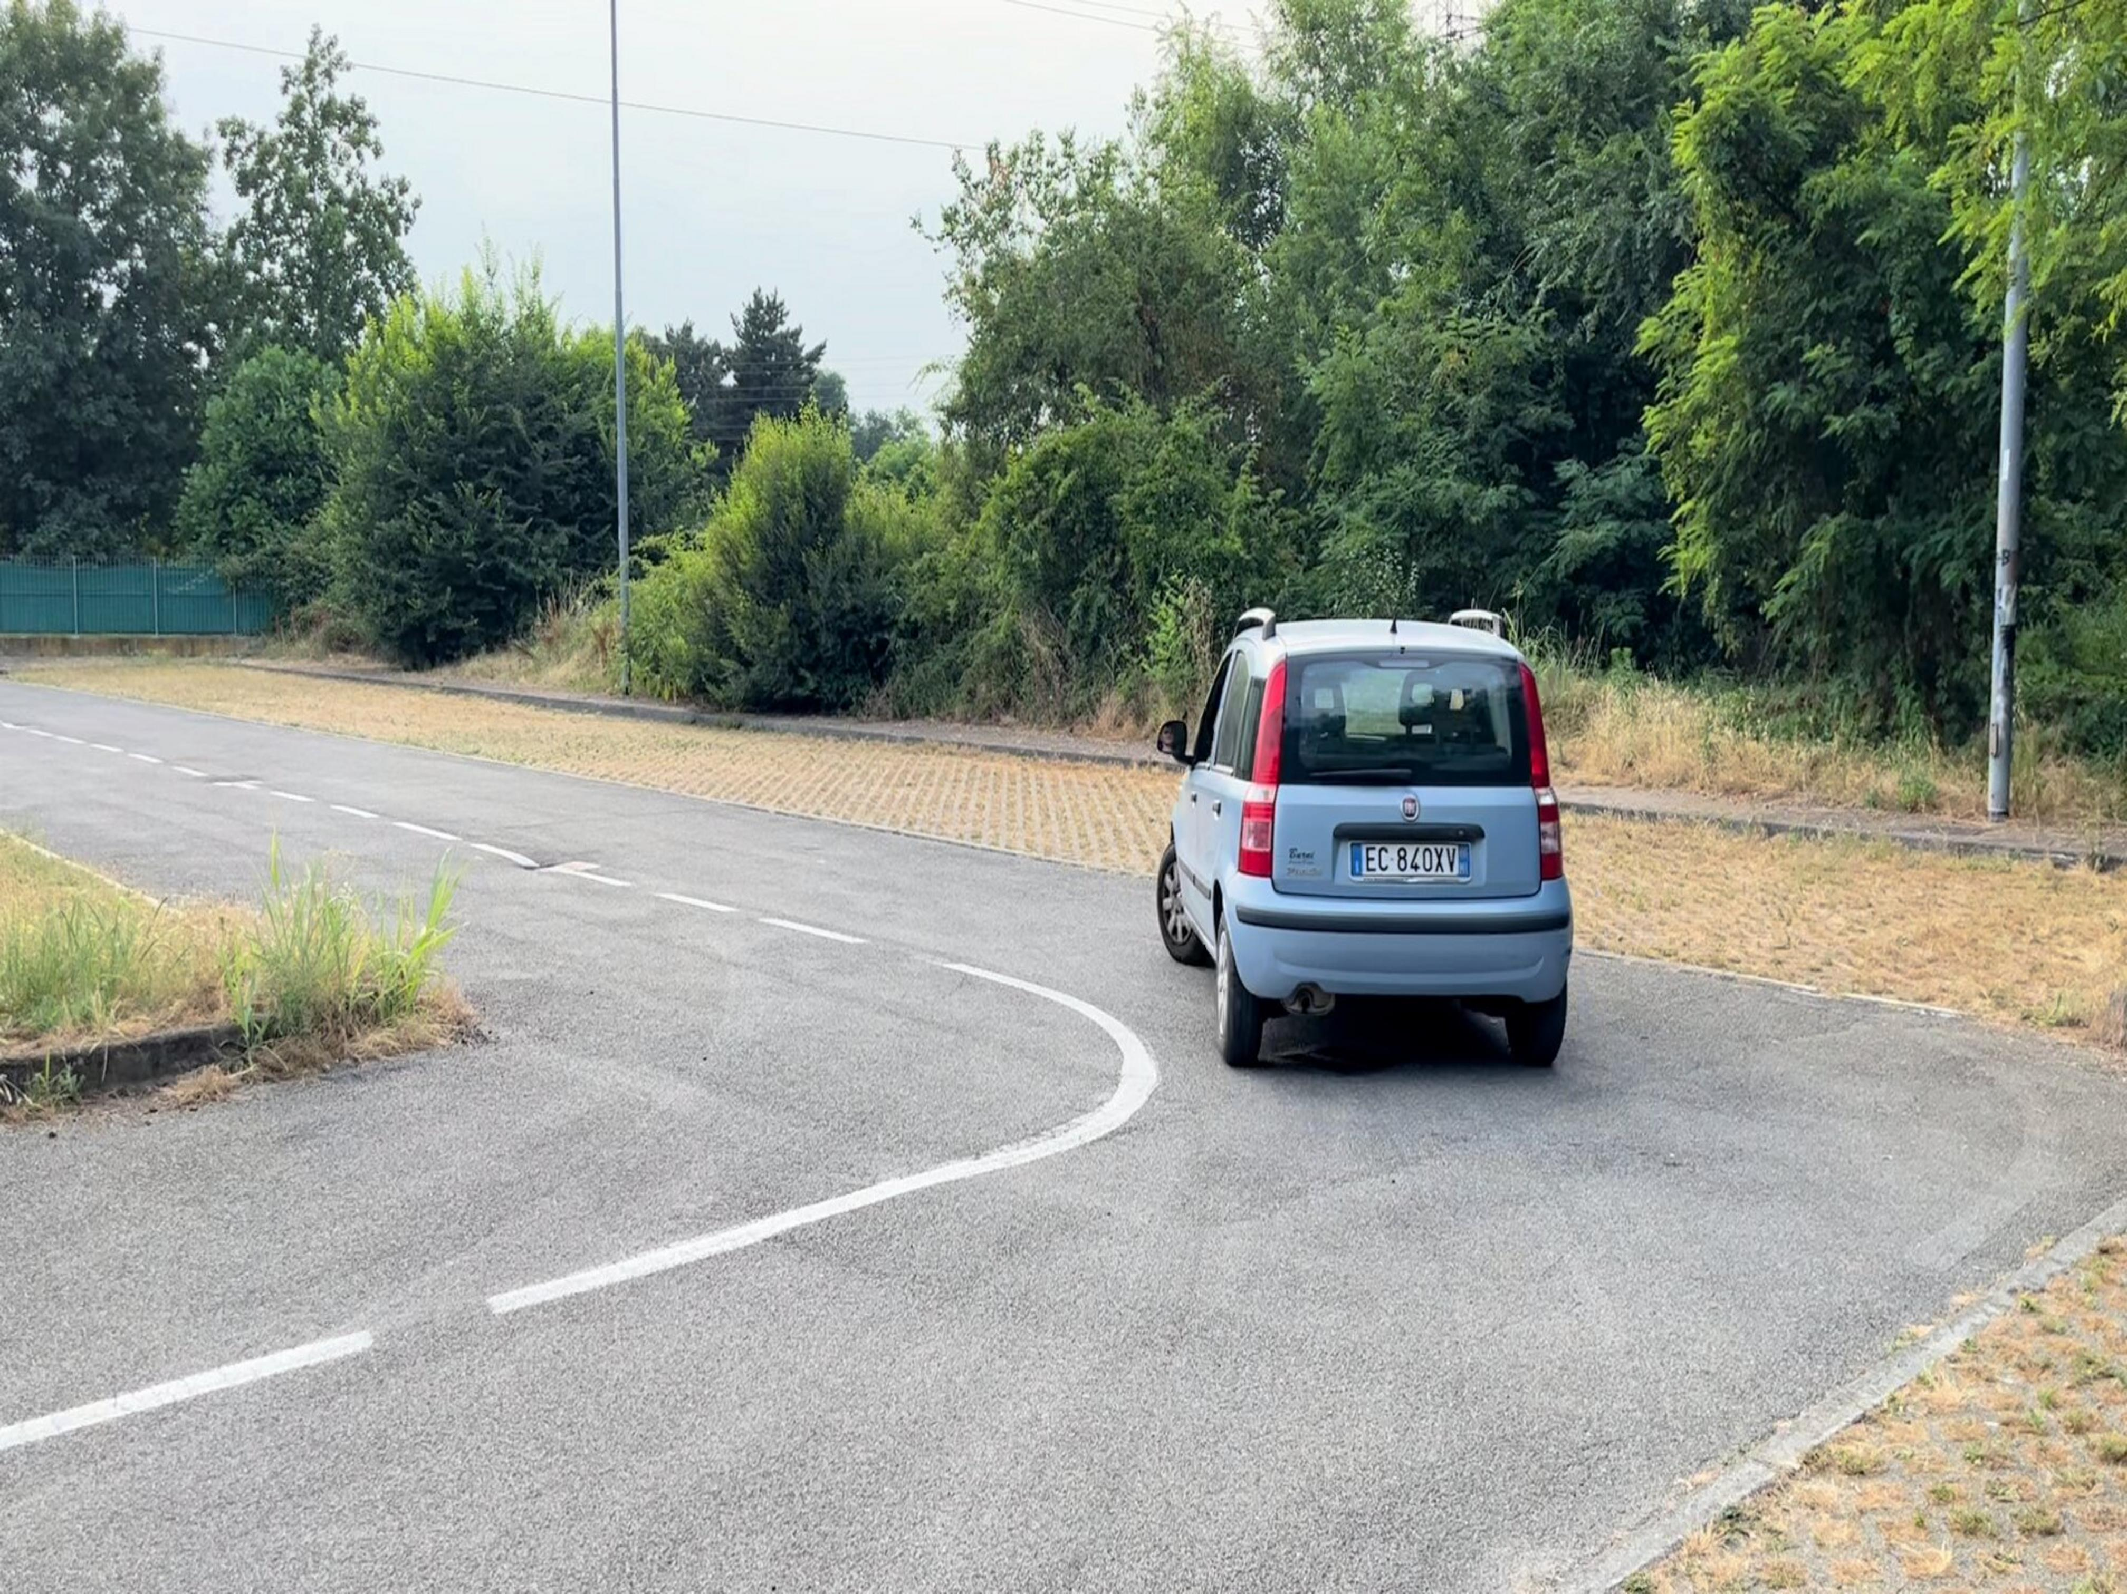
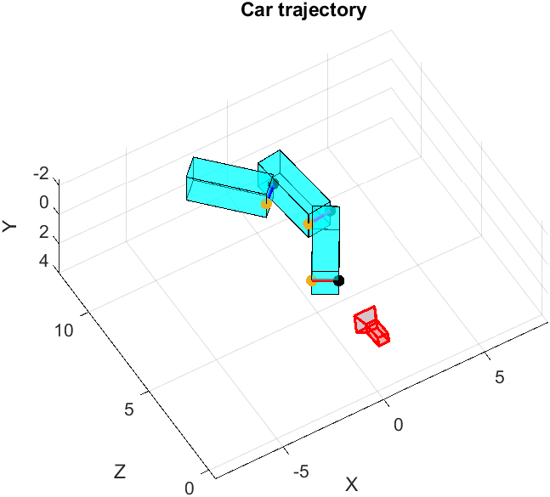
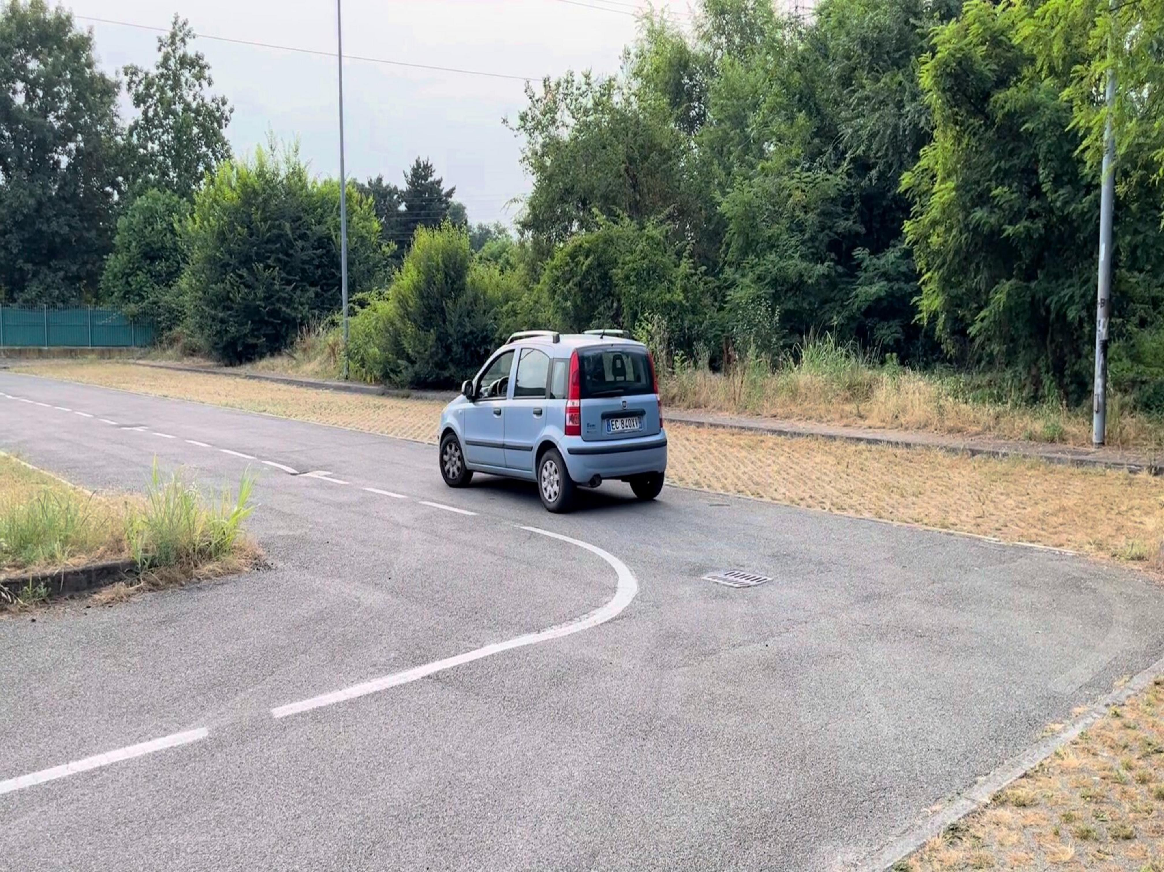
Point 2: Multi-Frame Trajectory Estimation
Point 2 >> Results
The results, using car frames, were satisfactory and sufficiently accurate for our purposes. Thanks to the testing phase and to the use of DLT, as a preprocessing step, the algorithm seems to be quite robust.
1
2
3

Slide 13
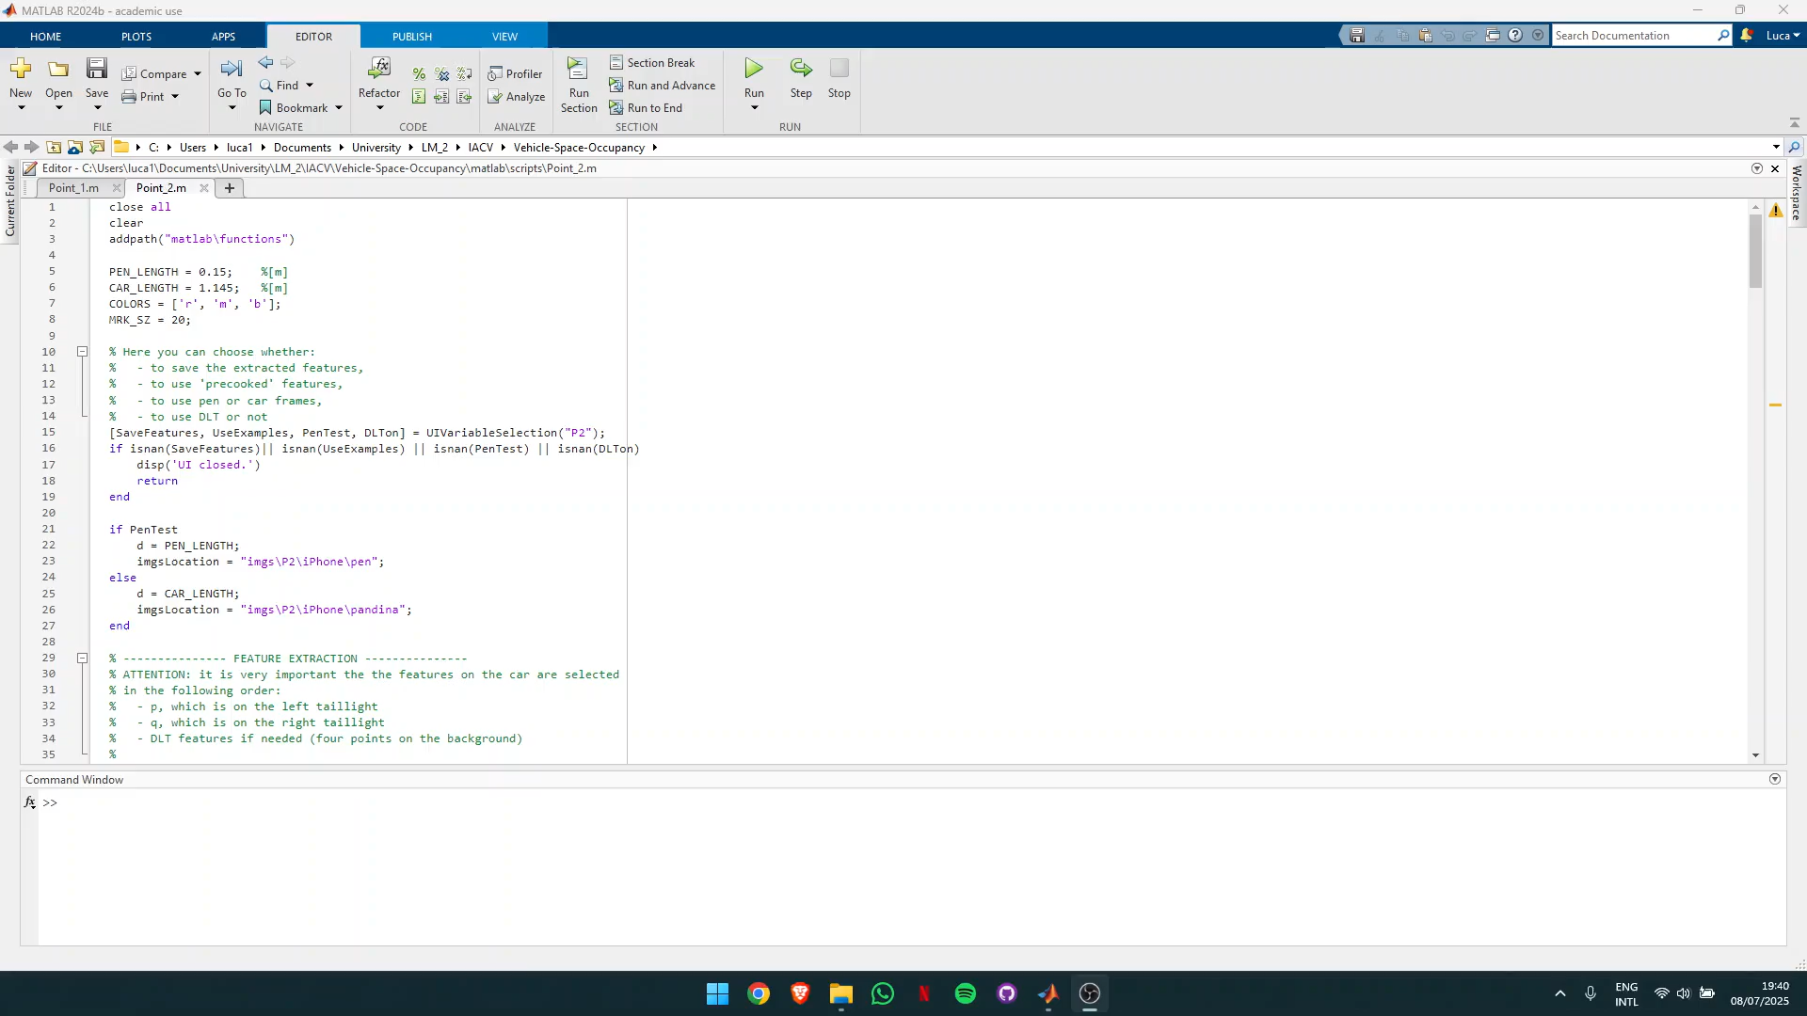
Point 1: Single Frame Vehicle Localization
Point 2 >> Small Demonstration
This and other videos can be found in the README.md file in the GitHub repository.

